Slide 1
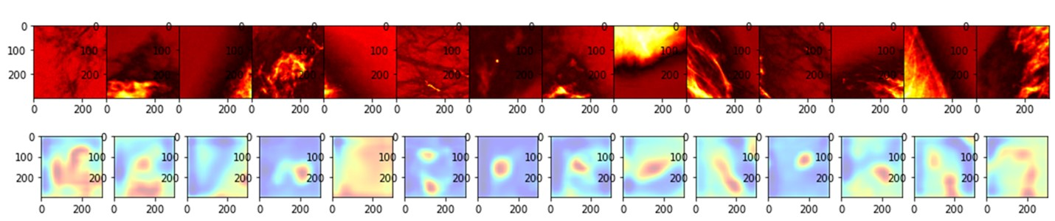
Deep Vision for Breast Cancer Classification & Segmentation-A Preliminary Investigation
Larry Fulton, Alex McLeod, Diane Dolezel, Nathan Bastian, Christopher Fulton
Fulton L, McLeod A, Dolezel D, Bastian N, Fulton CP. Deep Vision for Breast Cancer Classification and Segmentation. Cancers. 2021; 13(21):5384. https://doi.org/10.3390/cancers13215384

Slide 2
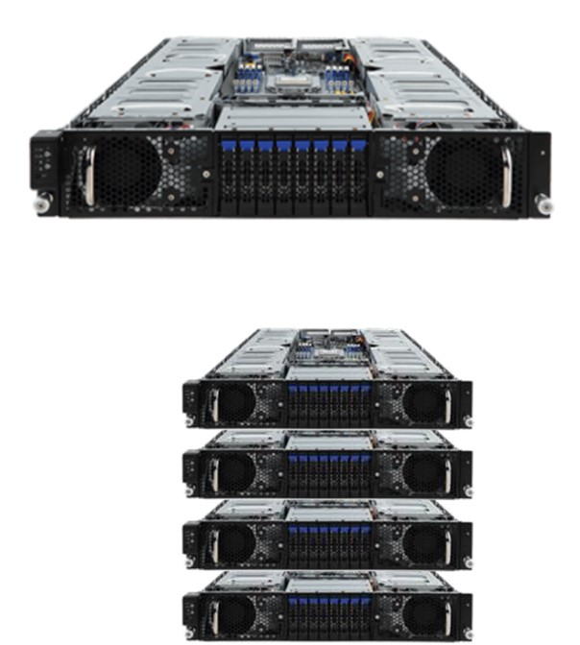
Acknowledgement to AMD
On Prem gift-in-Kind
EPYC Rome 48-core CPU
(8) Radeon Instinct MI50 GPUs
50TF compute capacity
Penguin On Demand (POD) cloud HPC
4 nodes of configuration above
Single tenant bare metal access
200TF compute capacity
One year of access, March 2021 – March 2022
Total Gift-in-Kind value : $440,000
We used this….and….
We will be using this for CDC project
(PLCOI 742).
"An in-kind high performance computing grant from Advanced Micro Devices (250 teraflops computing power) provided the computational power for model training."

Slide 3

Proposition
Failure to leverage machine learning for classification and segmentation of medical imagery is malpractice.
But can you sue an algorithm?
https://www.news-press.com/story/opinion/2021/01/24/florida-physicians-documented-malpractice-still-working-endangering-patients/4229232001/

Slide 4
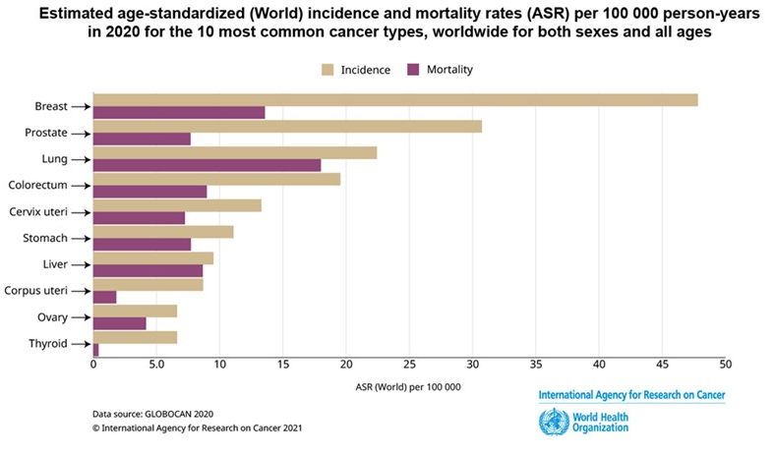
Background-Classification Problem
In 2020, 2.3M women were diagnosed with breast cancer
Odds have increased from 1:11 to 1:8 since 1975
Breast cancer is the 2d most fatal cancer (after lung cancer)
False Negative Rates (FNR) increase morbidity and mortality
False Positive Rates (FPR) result in overtreatment and stress
Traditional interpretation of studies results in 10% FPR and 20% FNR
Machine learning algorithms can do better

Slide 5
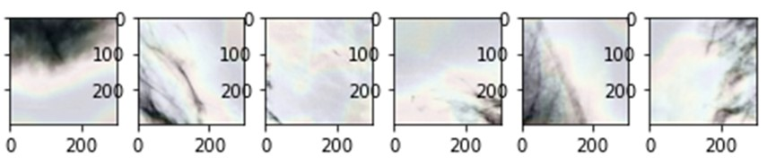
Background-Segmentation Problem
Image segmentation attempts to subdivide image areas
These subdivisions are used to identify possible malignancies
Recent efforts have sought to automate segmentation
Autonomous Regions of Interest (ROI) identification may highlight areas of concern on mammography, areas requiring secondary clinical review

Slide 6
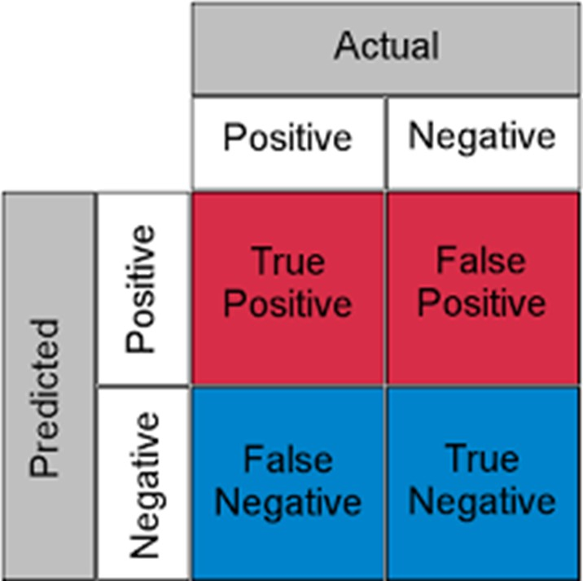
Study Problem
Address the problems of overdiagnoses and overtreatment as well as underdiagnoses with its associated increases in morbidity and mortality by
improving classification of mammography using supervised learning
implementing backpropagation to paint gradient contours of the ROIs using unsupervised learning

Slide 7
Personal Motivation
Relative with triple negative breast cancer
Mother with false positive diagnosis
Neighbor with recurrent breast cancer
2d leading cause of cancer deaths

Slide 8

Data, Software, Hardware
Data: Digital Database for Screening Mammography
71,249 images and labels divided into training, validation, and test sets
Image size: 299 x 299 x 3 channel (converted)
Total pixels: 299 x 299 x 3 x 71249 = 19.1 billion pixels
Software: Python
Hardware: AMD in-kind HPC Grant

Slide 9
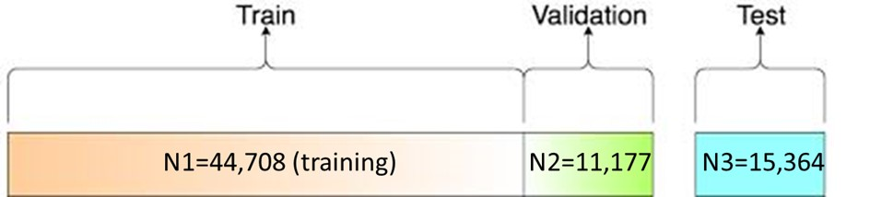
Training, Validation, Test Sets
N1=44,708 (training)
N2=11,177 (validation)
N3= 15,364 (test)
The final tuned model used both the training and validation sets to predict the pristine test set.
Each of the image intensity values were scaled. Test data remained untransformed other than pixel scaling. Label data were complete.

Slide 10
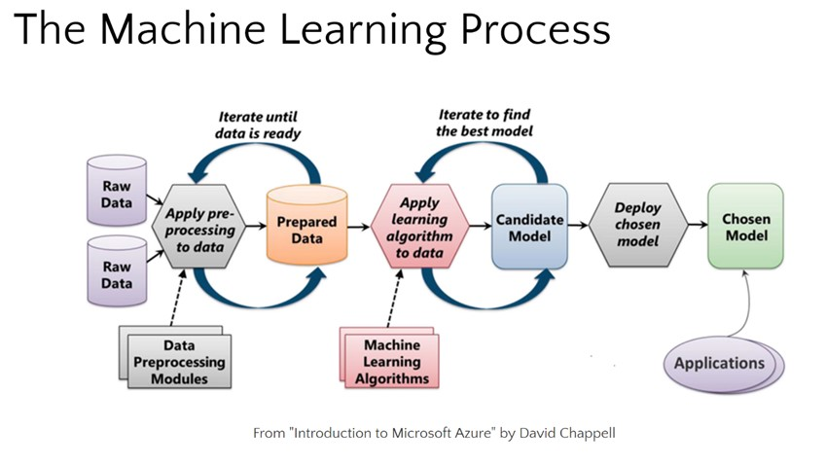
Image and Label Pre-Processing
Original images and labels were reviewed to validate data integrity.
Pixel values were scaled between 0 and 1 (originally grayscale between 0 and 255).
Single channel was converted to three channel for application of pre-built models (e.g., VGG-16).
All labels (non-anomalous vs. anomalous) were available.
Labels were kept a dichotomous for use of a log-loss function rather than one-hot encoded for use of the softmax function.

Slide 11
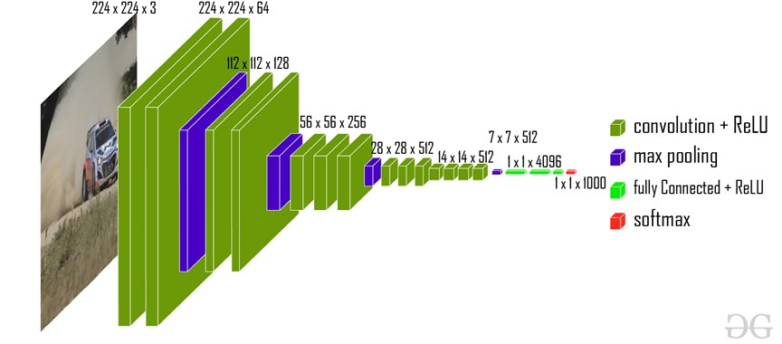
Deep Vision Basics
An image is as an x-y mapping of pixel color intensity, z.
For color images, 3 matrices form an array (one each for RGB).
ConvNet is a set of dimension reduction algorithms that reduce the image size while retaining important features and spatial information.
Multiple layers are stacked (hence the term 'deep') and continue to compress the image representation.
Prior to classification, the last layer is flattened and a typical dense neural net is appended.
The output may then be used to forecast class membership by minimizing a log-loss or ‘softmax’ function (think logistic or multinomial regression).
https://www.geeksforgeeks.org/vgg-16-cnn-model/

Slide 12
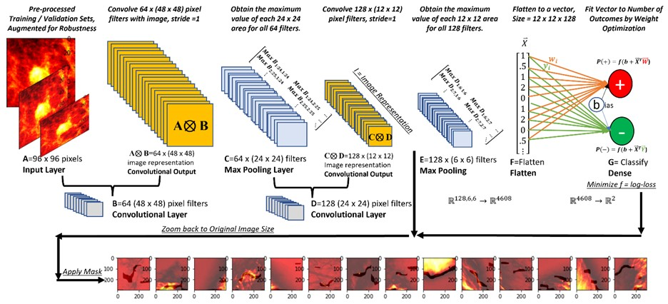
Example ConvNet (CNN)
Images of 96 × 96 pixels (‘A’ in Figure 1).
Multiple filters of smaller size (e.g., 48 × 48 pixels, ‘B’ in Figure 1) pass over the original image, pixel by pixel
The tensor product, A⦻B, is taken for each region
Moving each of our 48 × 48 filters over the original 96 × 96 images 1 pixel generates a new 48 × 48 matrix.
The output is passed through a function for classification improvement (a rectifier function that adds additional nonlinearity to images)
Smaller filters (24 × 24 pixels in Figure 1, ‘C’) are applied to convolutional layers.
These filters execute ‘maximum pooling’ (keeping the maximum value in each region)
Multiple layers (‘D’ and ‘E’ in Figure 1) are then combined in a network structure.
The final image representation is flattened into a single vector (dense layer, ‘F’ in Figure 1).
The inner product of this vector and weights (tuned through optimization) are added to a constant (bias) and processed through a function (‘G’ in Figure 1).
The softmax function provides the probability of negative (−) or non-negative (+) imagery Equation (1).

Slide 13

Applying the Filters: Sumproduct
Multiplied Elementwise Against Image
Randomly Generated Filter
And Summed
1 | 0 | 1
0 | 1 | 0
1 | 0 | 1
Filter
https://www.cc.gatech.edu/~san37/post/dlhc-cnn/

Slide 14

RGB Images
https://blog.roboflow.com/when-to-use-grayscale-as-a-preprocessing-step/

Slide 15

Stride = 2
https://www.freecodecamp.org/news/an-intuitive-guide-to-convolutional-neural-networks-260c2de0a050/

Slide 16

Max Pooling (Reduction and Extraction of Important Features / Reducing Noise)
https://www.analyticsvidhya.com/blog/2021/05/convolutional-neural-networks-cnn/

Slide 17

Architecture- Convolutional Neural Network (ConvNet or CNN)

Slide 18
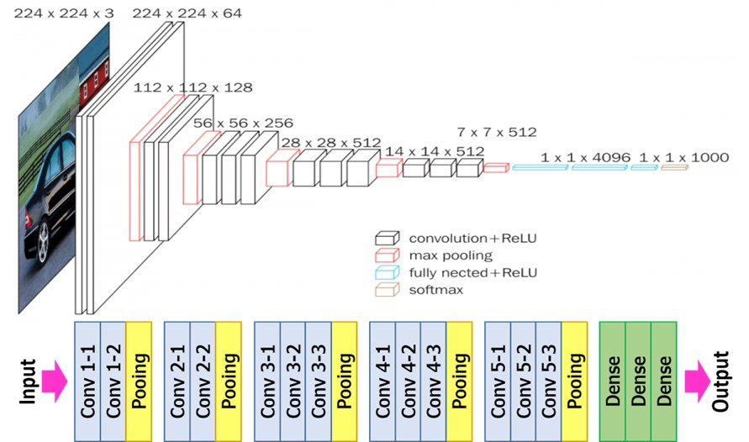
Specific Classification Architecture Visual Geometry Group (VGG) – 16 (Oxford)
VGG-16 includes 13 convolutional layers, 3 dense layers, and 5 maximum pooling layers.
Global average pooling was added to this baseline architecture to further reduce dimensionality.
A single neuron with sigmoid activation function provided the final estimate of the probability of a non-negative result.
Pre-trained weights (Image.net) were updated during nonlinear optimization.
Images were batched in groups of 32 and fed into the architecture.
Validation metrics were estimated
Hyperparameter tuning was performed.
The nonlinear optimizer was an adaptive gradient algorithm known as ‘AdaGrad’.
50 epochs were set with early stopping conditions (which activated after epoch 25).
Features (filters) increase while dimensionality decreases.
https://neurohive.io/en/popular-networks/vgg16/

Slide 19
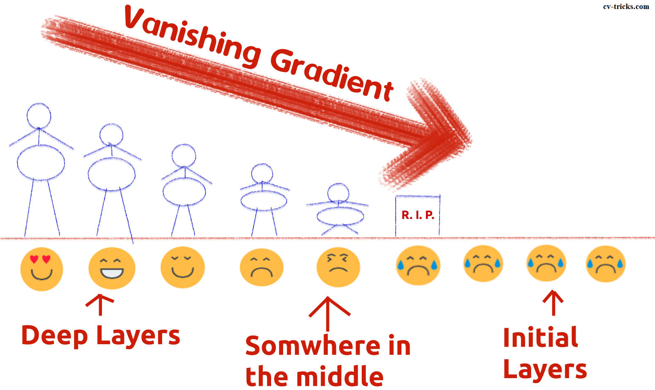
Other Architectures Investigated / Issues
ResNet50V2
MobileNetV2
Others
Exploding gradient? Limit gradient size during training
Vanishing gradient? Skip connections (e.g., ResNet), weight normalization
Noisy? Autoencoding
Image Augmentation? No increased performance
https://cv-tricks.com/keras/understand-implement-resnets/

Slide 20
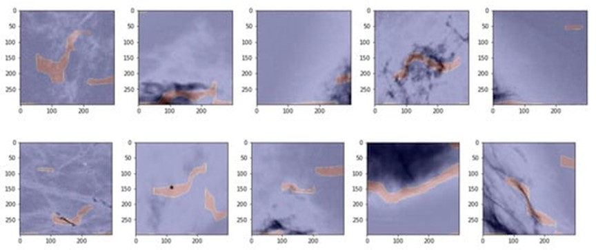
Unsupervised ROI Identification
Traditional radiological imagery is often devoid of ROI segmentation
Without previously identified ROIs, supervised methods are not possible
It is possible to return a small image representation from the closest convolutional layer of a model, evaluate the gradient of the loss function with respect to the image representation at that layer using computational graphs, find the portion of the gradient that maximizes the classification probability, and re-map that gradient location back to the original image.
In doing so, the areas of the original image that are most highly influential for the classification model can be found.

Slide 21
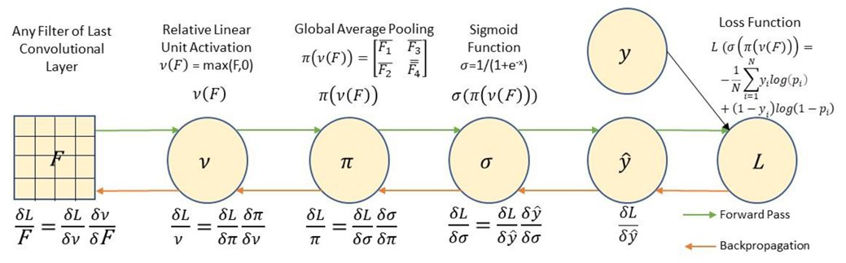
Unsupervised Region of Interest Identification
When fitting a ConvNet, the result is a composite function (green arrows).
Backpropagation using partial derivatives allows for the recreation of the important parts of the images that are associated with the loss function (red arrows).
Saving gradients at each stage allows for image representation (tf.GradientTape).

Slide 22
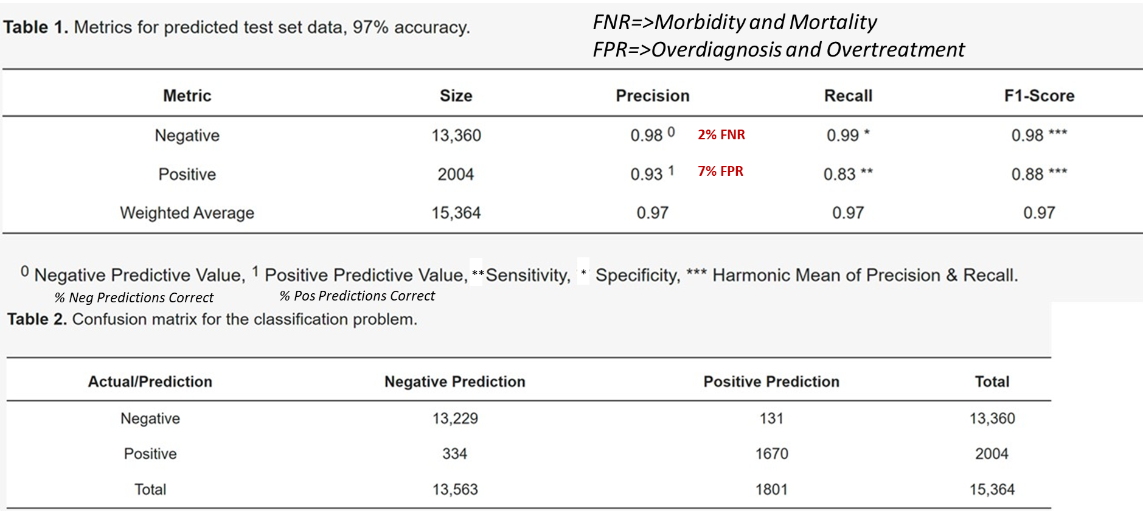
Results-Classification

Slide 23
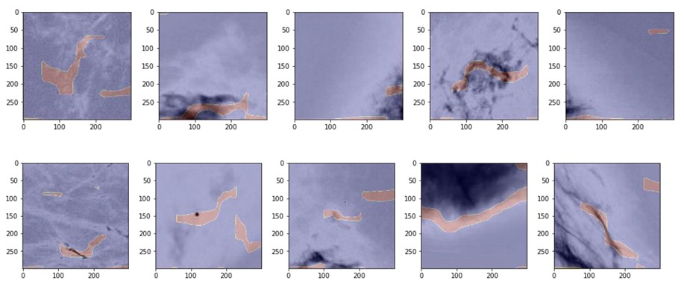
Results-Unsupervised Segmentation
Shown are the first 10 positive images in the data set in gray scale with the top 5% of the gradient values superimposed (pink).
In Row 1, plots 2 through 5 and in Row 2 plots 3 through 5, it is clear that the gradient of the loss with respect to the image representation considers the darkish areas to be associated with anomalies.
In Row 2, plots 1 and 2 appear to identify a high density ‘line’ and ‘point’, respectively. The contour plots appear to capture the boundaries of interesting tissue in the plots, which is to be expected, as the maximum values of the gradient of the loss with respect to the image representation are those areas most closely associated with the algorithm’s classification decision.

Slide 24
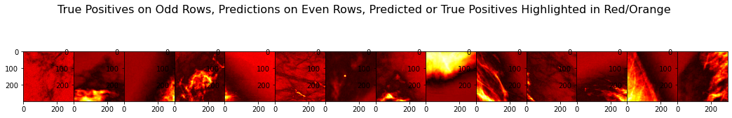

Slide 25
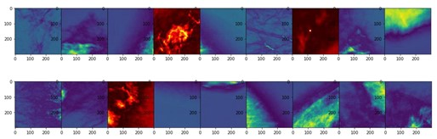
Discussion-Classification
Supervised classification of mammography detection is effective in achieving high sensitivity, specificity, precision, and overall accuracy. The model presented here was highly specific (99%) with reasonable sensitivity (83%).
This particular model would effectively address the problems of overdiagnosis and overtreatment, and slightly address the problems of morbidity and mortality associated with breast cancer.
Refinements to the architecture, weights, and other elements of the model would be expected to improve its performance; however, a relatively common ConvNet architecture was capable of achieving these results on a sufficiently large dataset with reasonably sized images without significant hyperparameter tuning or image manipulation.

Slide 26
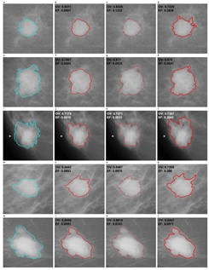
Discussion-Segmentation
Backpropagation techniques worked well to produce contour maps for the loss gradient with respect to the image representation. Zooming these contour maps from the last convolutional layer back to the original image size provided reasonable visual representation of the areas that are (by definition) most closely associated with the classification process.
Thus, it is relatively straightforward to determine regions of interest during the ML classification process without running separate models.
Providing pre-marked images to physicians, particularly when ML models and physicians have different ‘opinions’ regarding the mammography, is an important consideration for improving FPR and FNR rates.

Slide 27

Limitations & Future Work
A limitation of this study is that it uses previously curated images of fixed and relatively small size.
Larger files (e.g., Aperio ScanScope.svs image sets) require significantly more preprocessing and computational power.
The positive mammography lacks confirmed ROIs, so the contour masks may not be interpreted alone.
Classification using the BI-RADS classification scheme is also possible but beyond the scope of this initial study.
Future work involving imagery and non-imagery data obtained by the National Cancer Institute under a Data Transfer Agreement (PLCOI 742) is ongoing.
Implementation of the classification and segmentation using TensorFlow Lite on photos of mammography is ongoing.
This work requires significant processing power from a cloud-based high performance computing cluster supported by Advanced Micro Devices under an in-kind grant.

Slide 28

Questions?

